Slide 1
Protect secrets
ow

Slide 2
overview
Secret Scanning push protection: check if code pushes include commits that expose secrets such as credentials
Secret Scanning repo scanning: scan your repository and look for exposed secrets that were committed accidentally

Slide 3
Scan
You can enable Advanced Security at the organization, project, or repository level. To access each of the scanning tools and results, you need to first enable Advanced Security.
Once you enable Advanced Security, any future pushes containing secrets to a repository with this policy enabled are blocked, and repository secret scanning happens in the background.

Slide 4
Lab:
Enable secret alerts

Slide 5
Manage secret scanning alerts
Anyone with contributor permissions for a repository can view a summary of all alerts for a repository in the Advanced Security tab under Repos. Select on the Secrets tab to view all secret scanning alerts.
If Advanced Security was recently enabled for your repository, you may see a card indicating that Advanced Security is still scanning your repository.

Slide 6
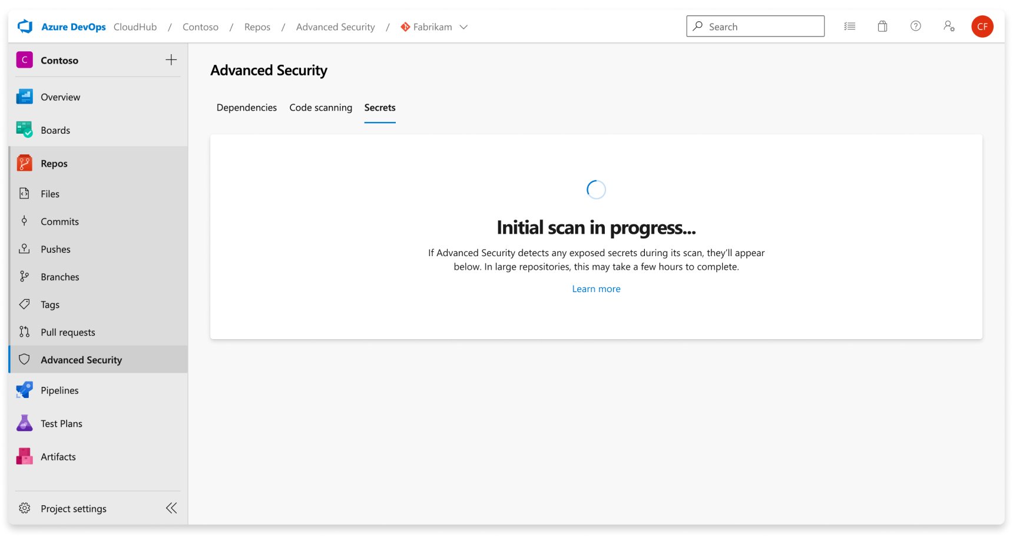
..

Slide 7
..
Once the scan is complete, any results are displayed. A single alert gets generated for each detected unique credential, across all branches and history of your repository. There are no branch filters as they're rolled up into one alert.

Slide 8
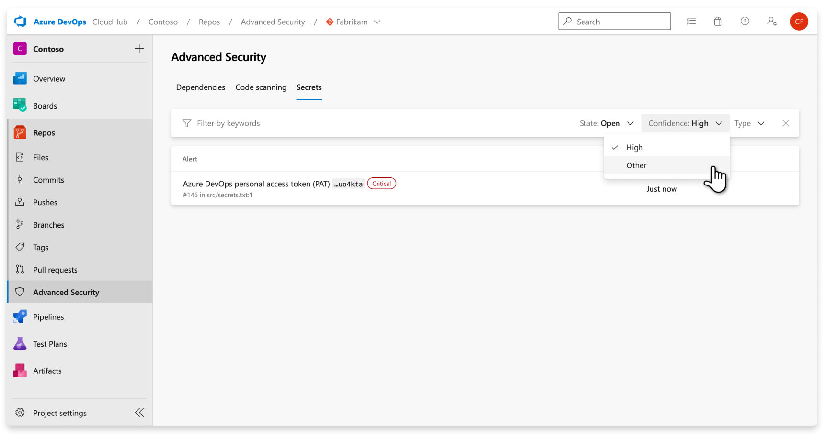
..

Slide 9
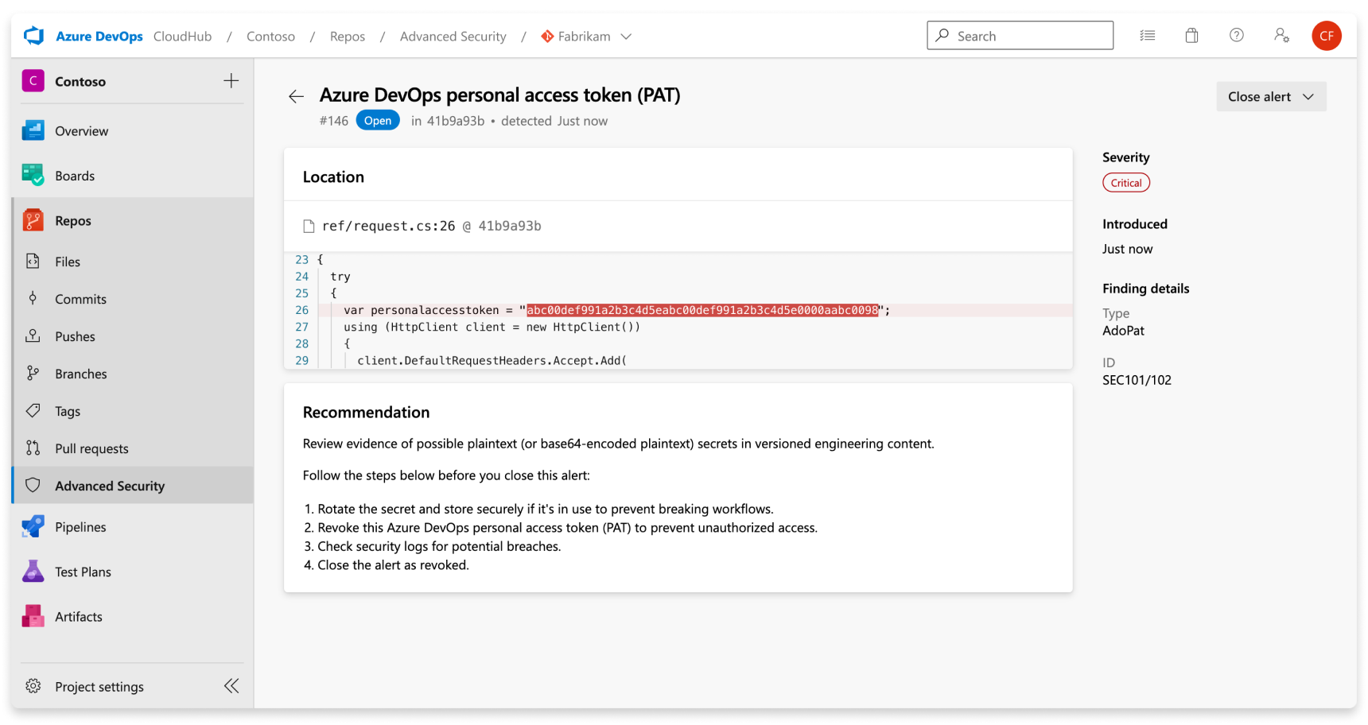
Alert details

